Slide 1
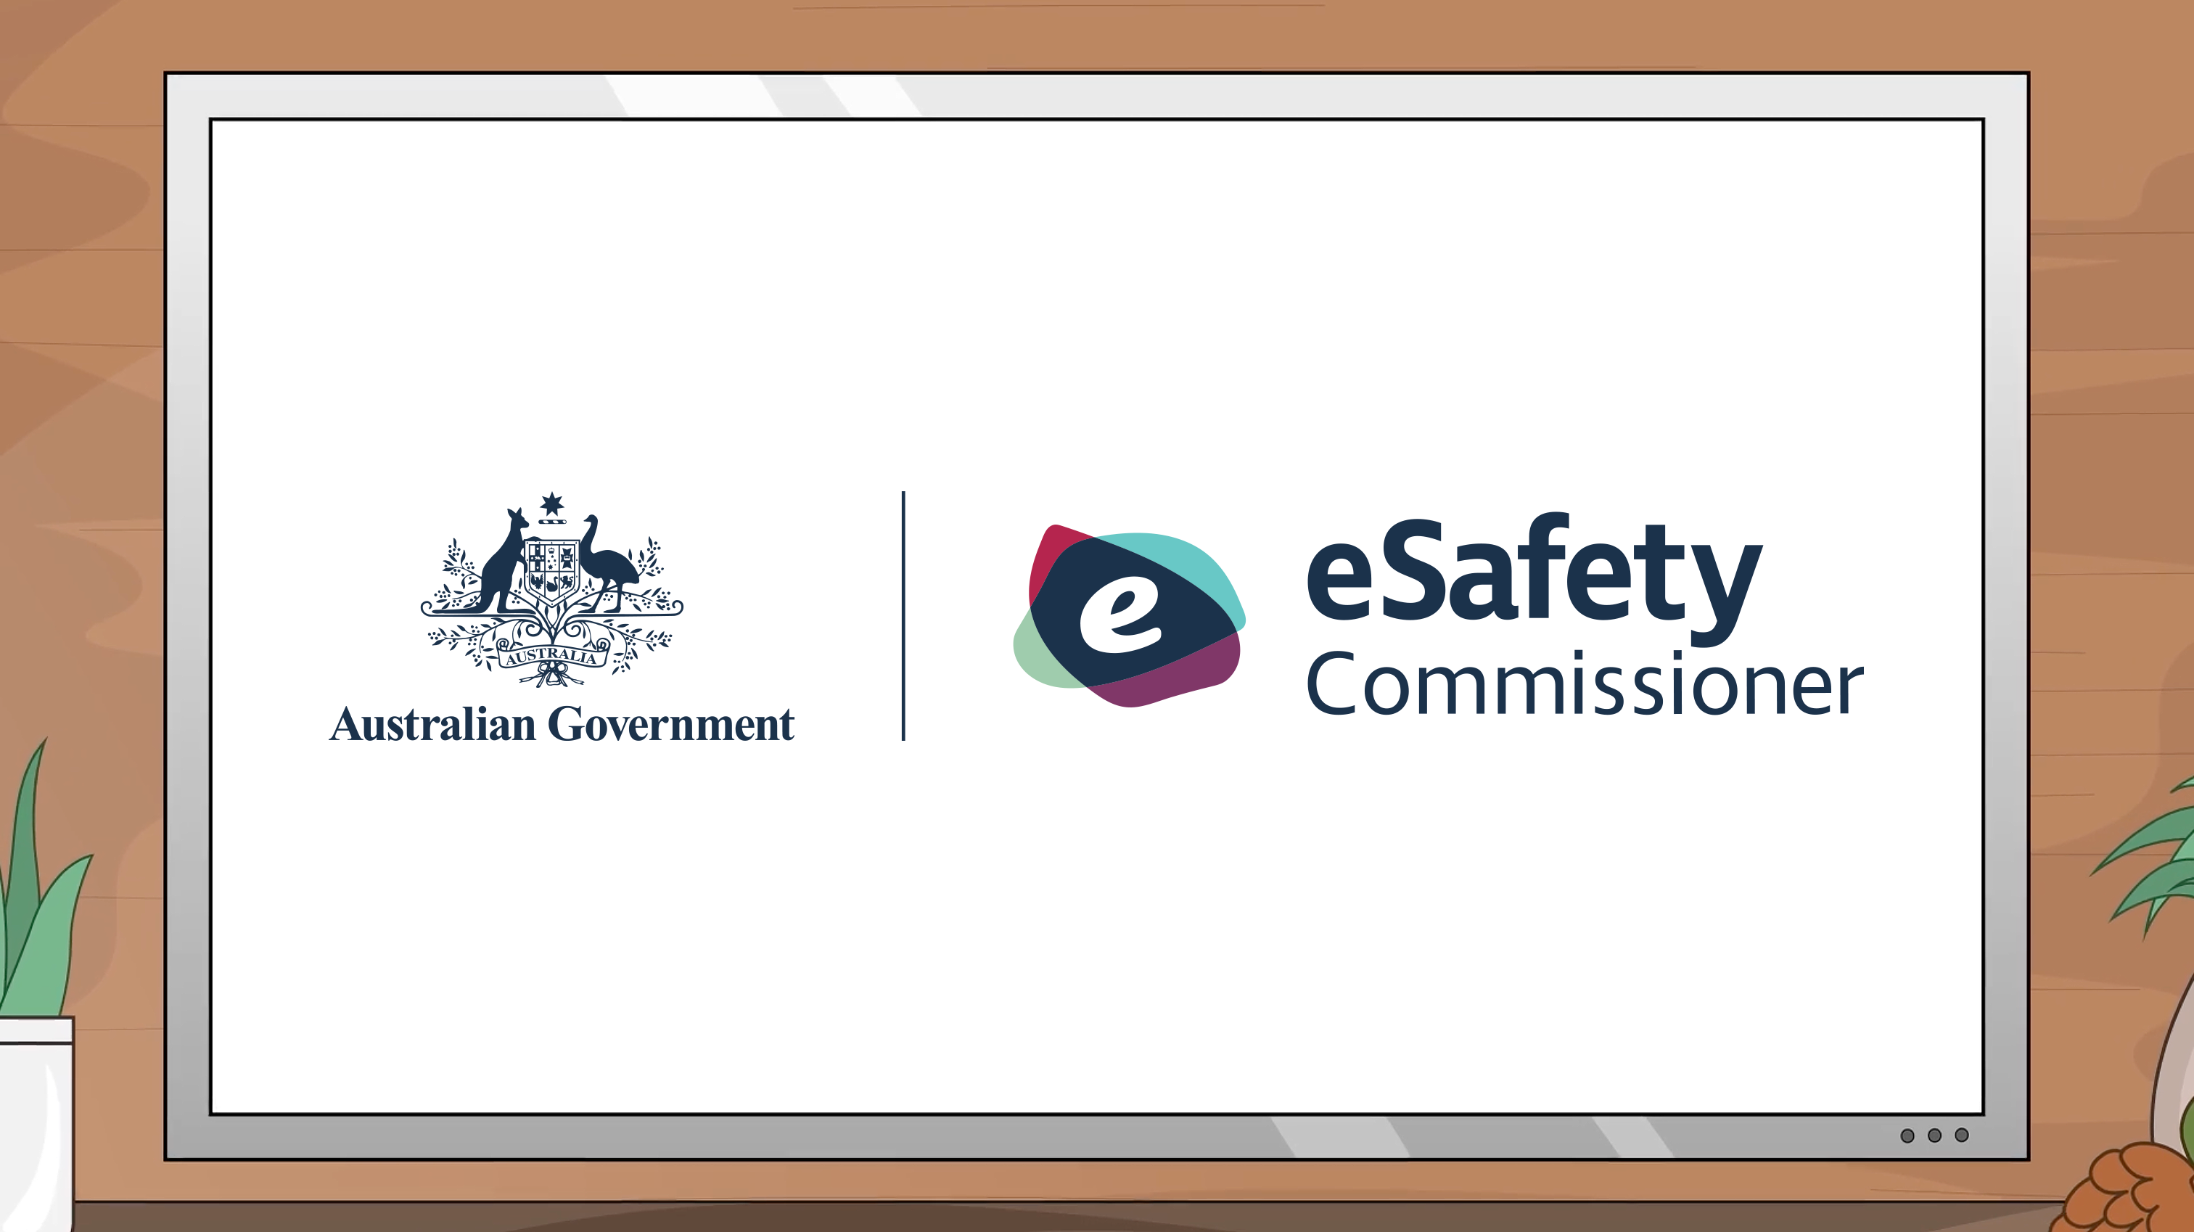
Notes:
Title slide
​
Note: View the PowerPoint in Slide Show mode with the notes or script visible to you so you can read it aloud. There are animations on some slides that are only visible in Slide Show mode. If you are having trouble, you can export the slides and notes as a PDF.

Slide 2
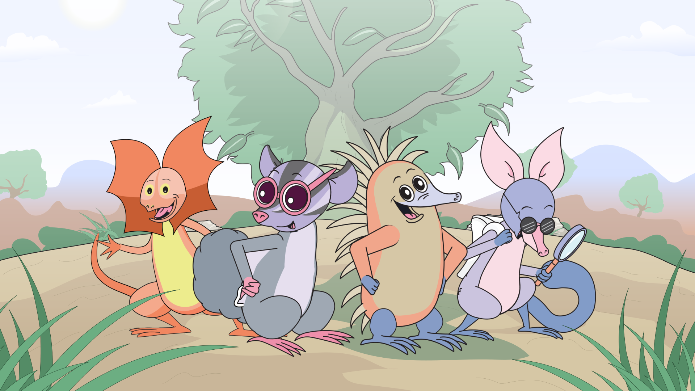

Notes:
Script
Let’s meet the Mighty Heroes! These Mighty Heroes each have their own superpower that keeps them safe online.
Let’s go on an adventure with the Mighty Heroes as they play an online game together.

Slide 3
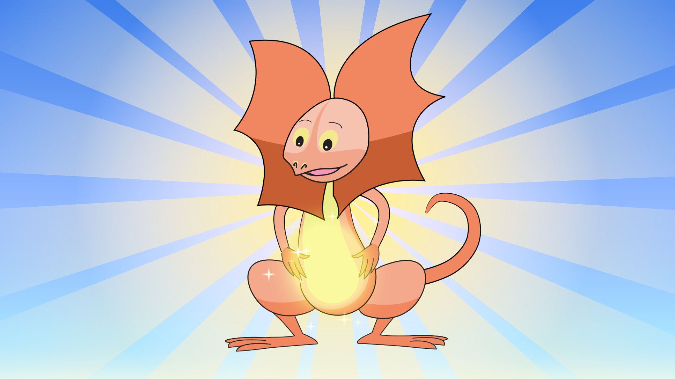
Notes:
Script
First, let’s meet Dusty the frilled neck lizard.
Dusty’s superpower is ‘Trusting your feelings’. When something doesn’t feel right, Dusty knows to ask a trusted adult for help!
Did you know that frilled neck lizards run on their back two legs? And they can grow up to one-metre long?
[Source: Northern Territory Government, nt.gov.au/environment/animals/wildlife-in-nt/frilled-neck-lizard]

Slide 4
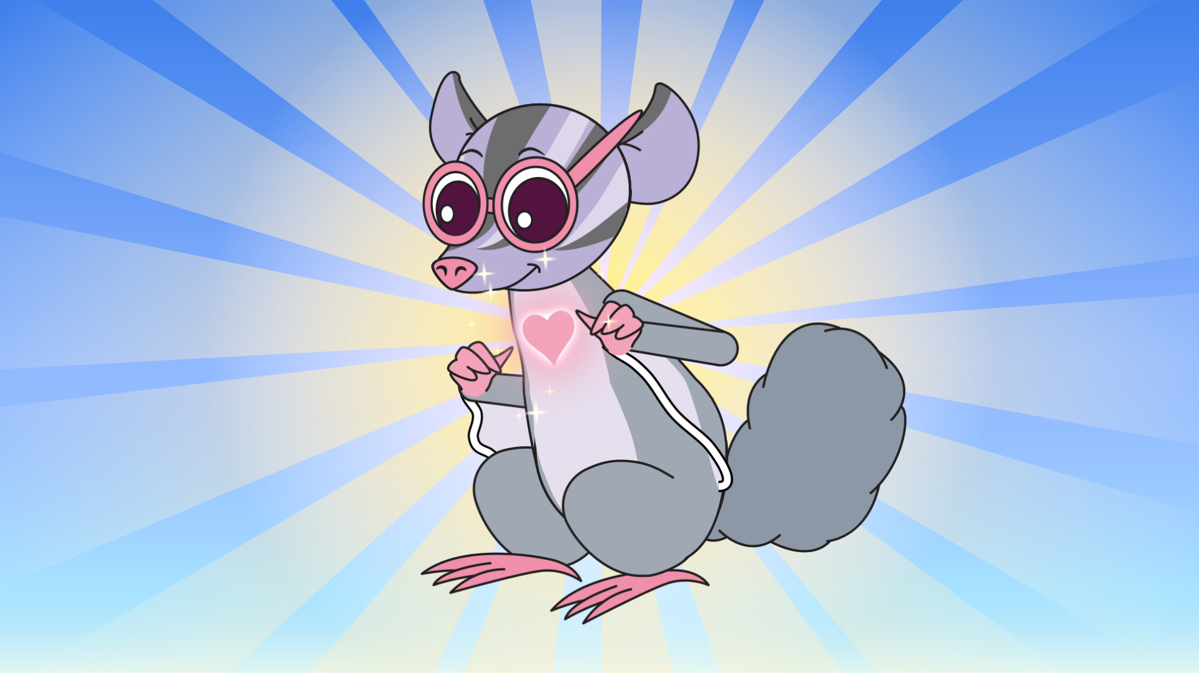
Notes:
Script
Here’s River. She’s a sugar glider and her superpower is ‘Respect’. River knows how important it is to be kind and respect others online.
Sugar gliders live in tree hollows and make nests out of leaves. They love sweet food!
[Source: Australian Wildlife Conservancy, australianwildlife.org/wildlife/sugar-glider]

Slide 5
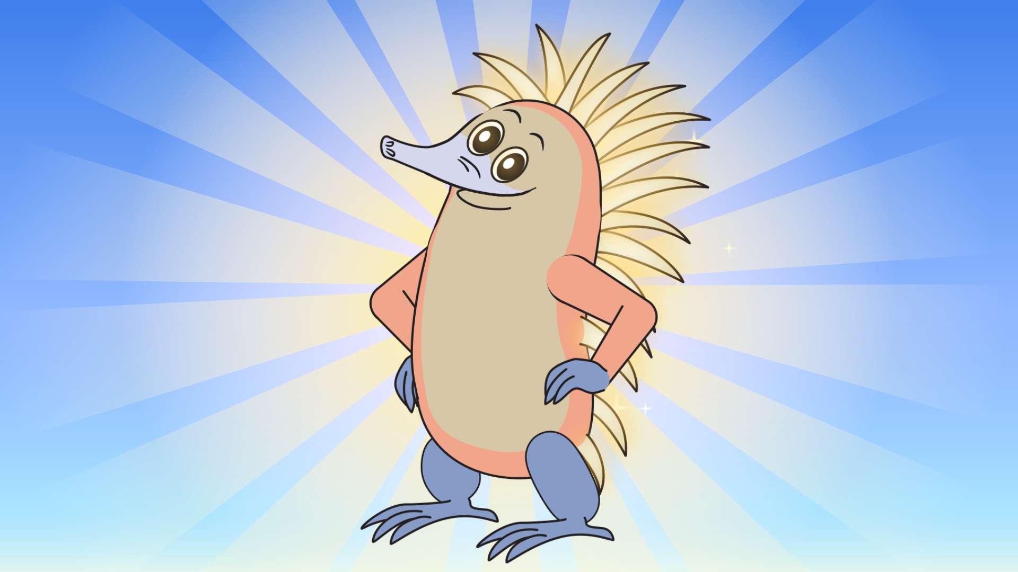
Notes:
Script
And introducing Wanda the echidna! Her superpower is ‘Responsibility’. Wanda knows to protect her personal information online.
Echidnas don’t have any teeth but they have long sticky tongues good for eating ants. Baby echidnas are called puggles!
[Source: Good Living, environment.sa.gov.au/goodliving/posts/2019/01/echidna-facts]

Slide 6
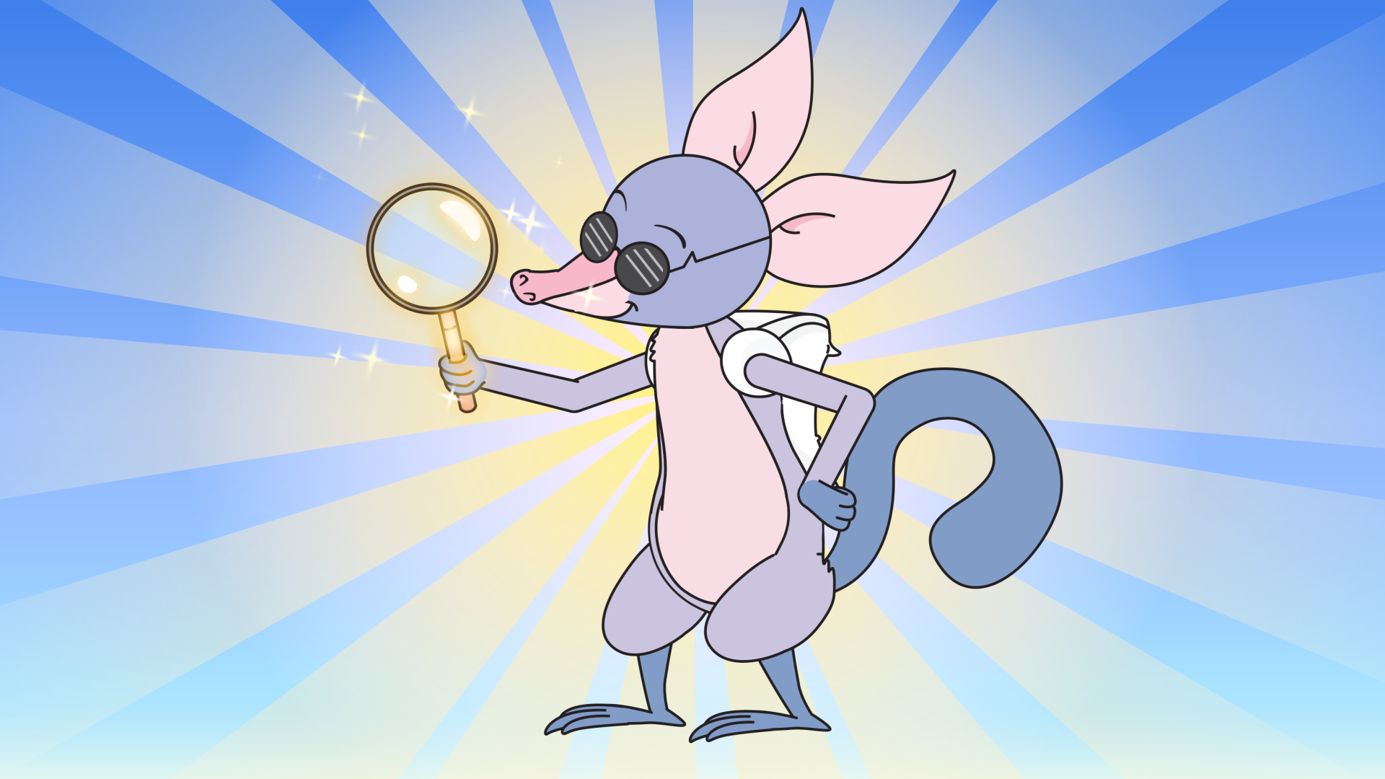
Notes:
Script
And last of our Mighty Heroes is Billie the bilby. Billie’s superpower is ‘Investigation’.
He follows the clues to sort fact from fiction when online.
Bilbies live in burrows in the ground and make tunnels that are sometimes two metres deep!
[Source: Australian Academy of Science, youtube.com/watch?v=vqZnk4X24F8]

Slide 7
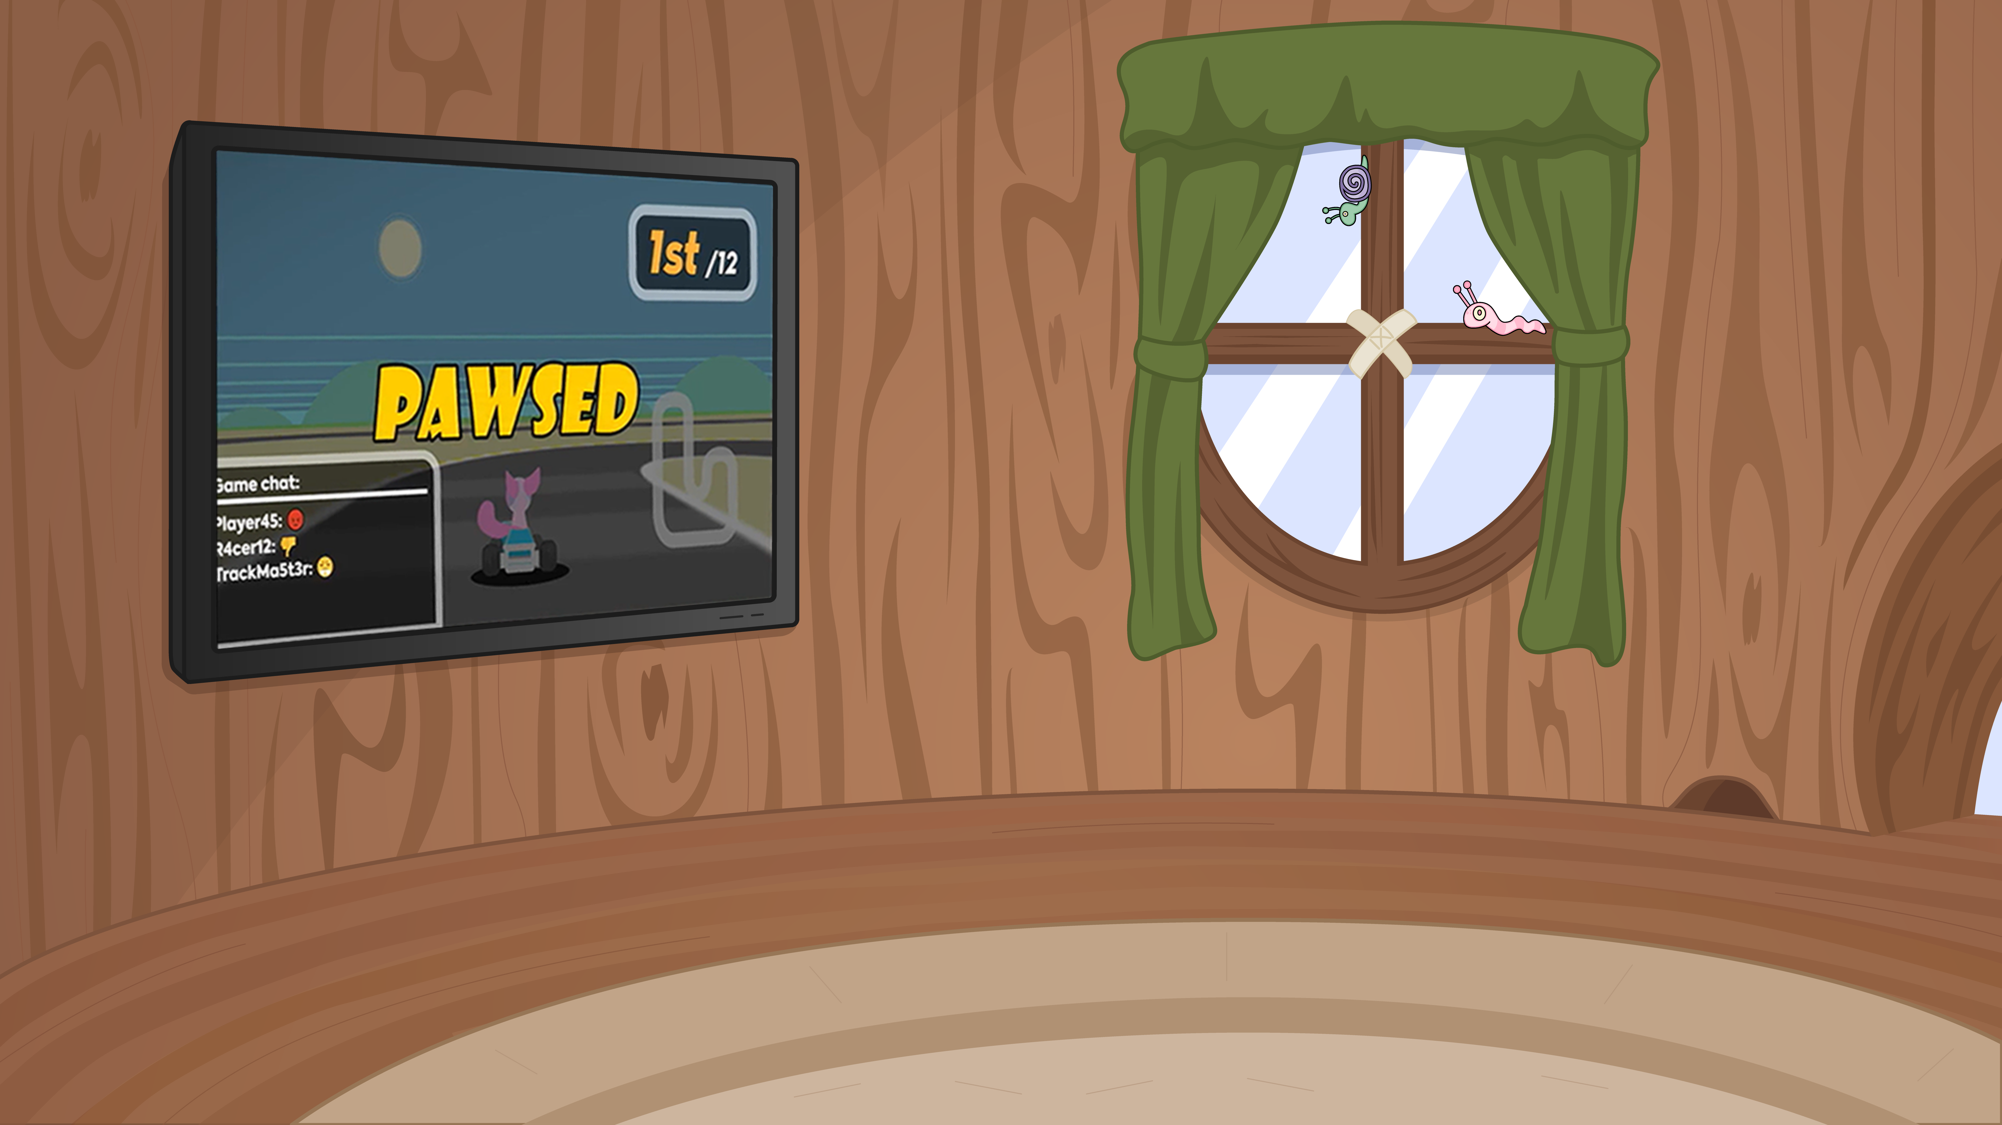
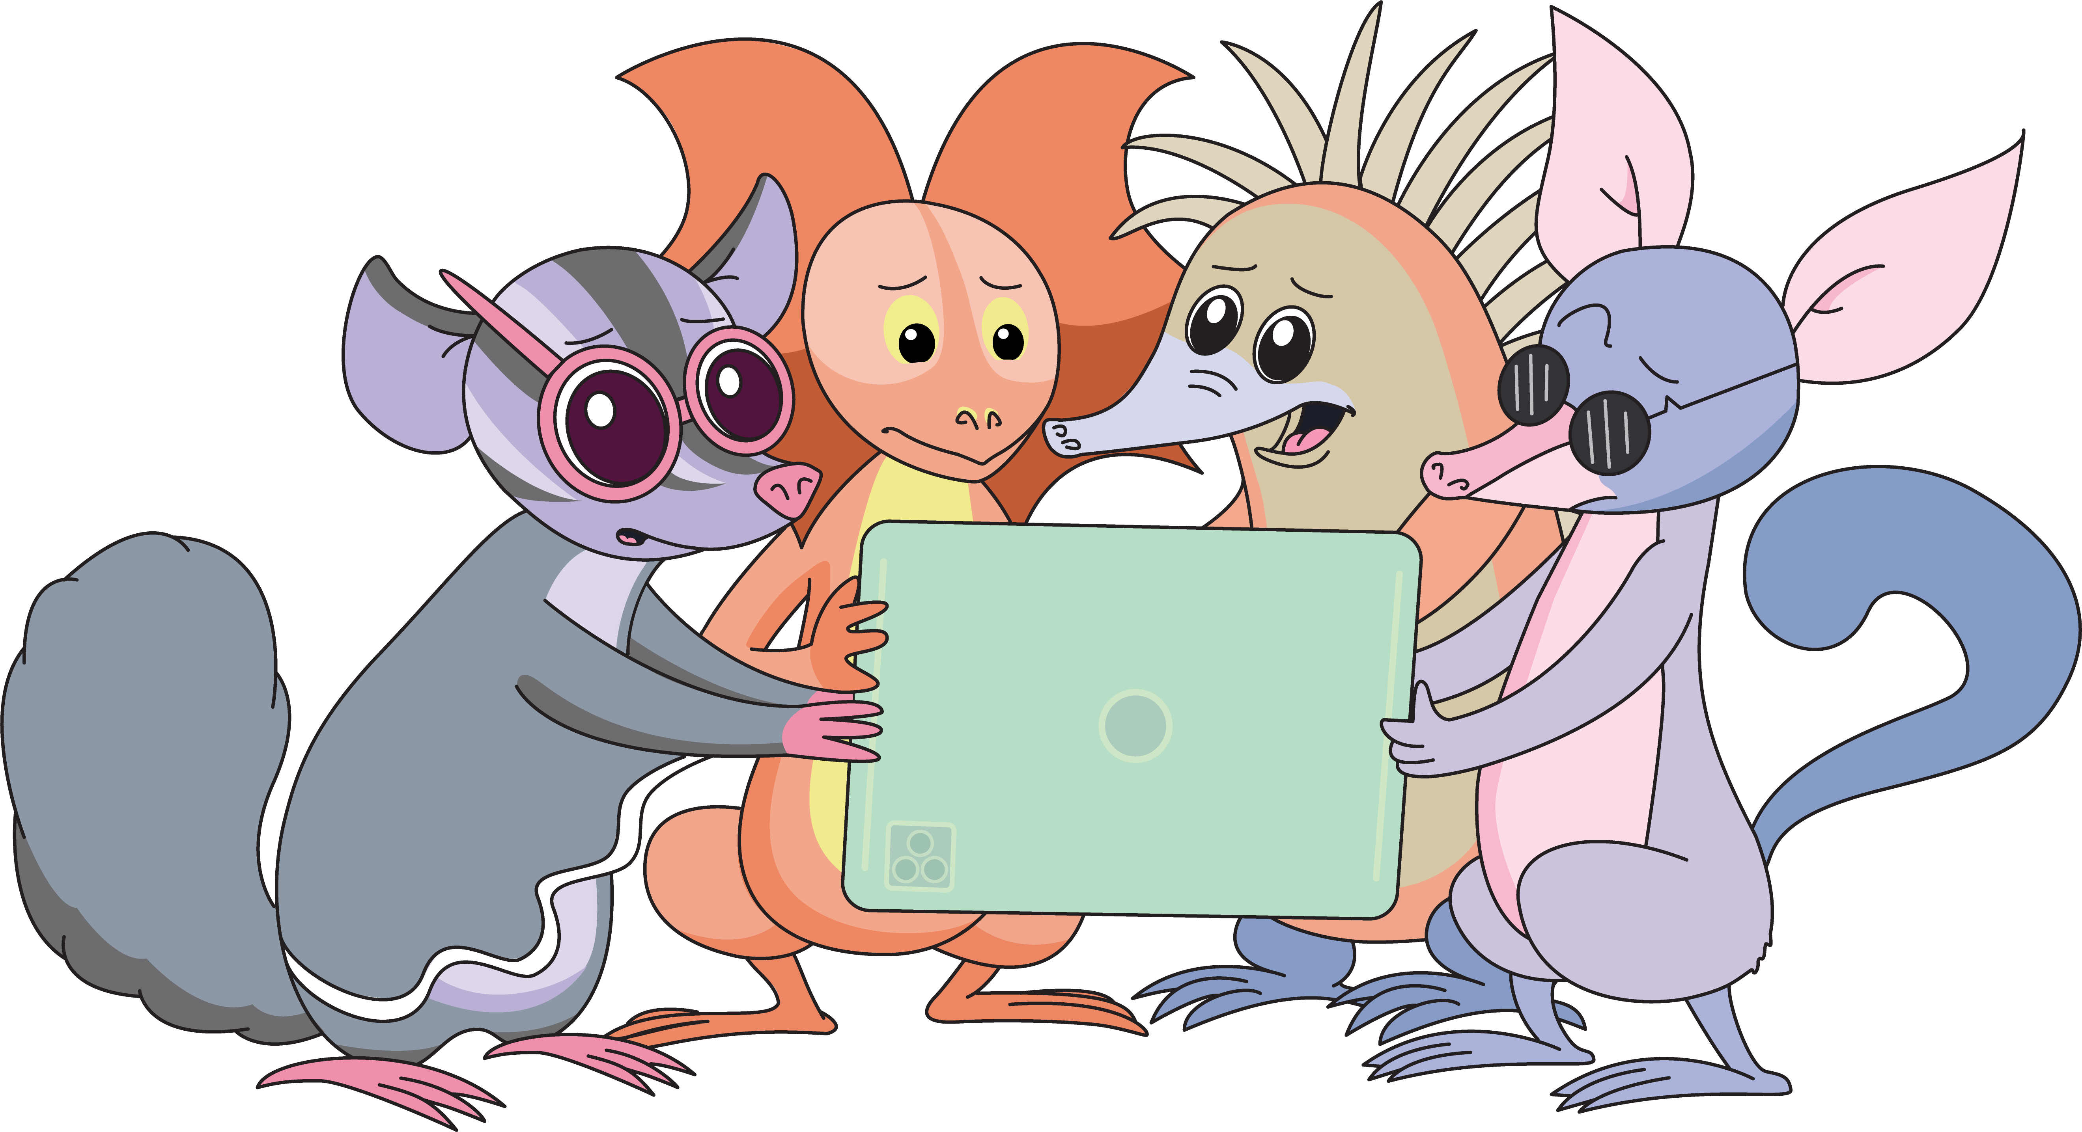
Notes:
Script
One day, the Mighty Heroes are playing a game together. They have a team called the Marsupials – and they’re really good!
But on this day, they get totally stuck in the game.
Billie remembers that his older cousin searched on YouTube online when he got stuck.
So the Mighty Heroes decide to do that too.
They find a great gamer tip video, but then…

Slide 8
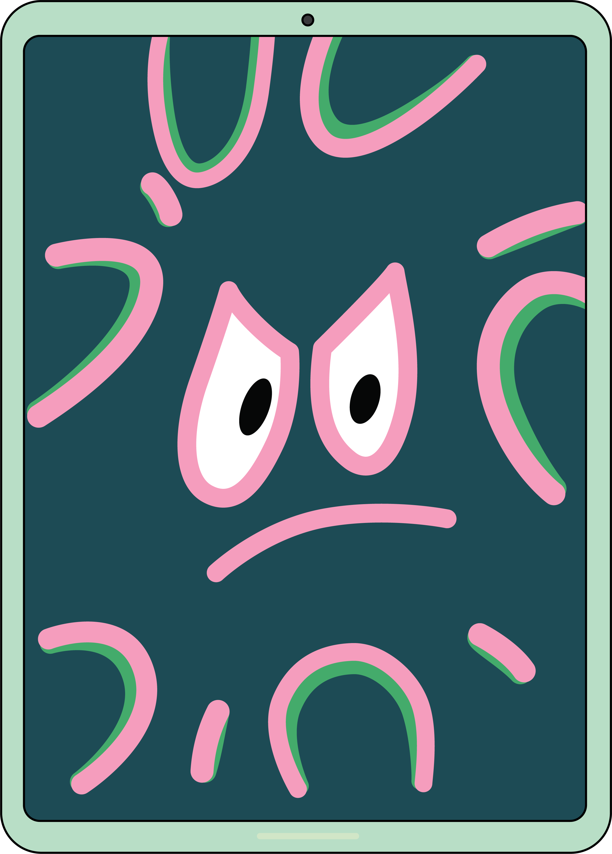
Notes:
Script
…another video plays straight after – and it’s not for kids! It’s really scary…​
​
How do our Mighty Heroes feel when they see the video?

Slide 9
Notes:
Script
Wanda has a funny feeling. She curls right up into a little ball – her spikes are up!

Slide 10
Notes:
Script
Dusty starts to get a funny feeling in his tummy – he knows something doesn’t feel right!

Slide 11
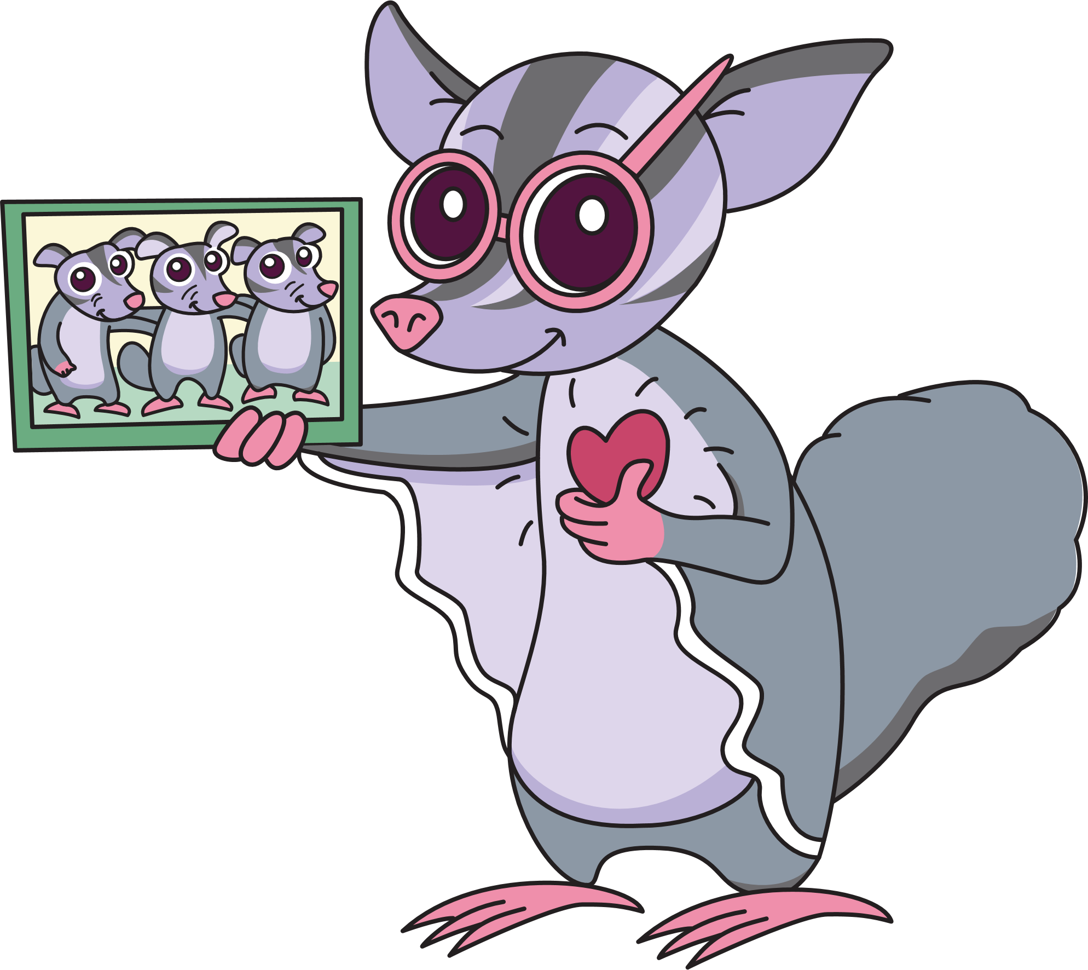
Notes:
Script
River’s heart starts to beat really quicky – boo boom, boo boom – and her legs feel shaky.
A bit like jelly!

Slide 12
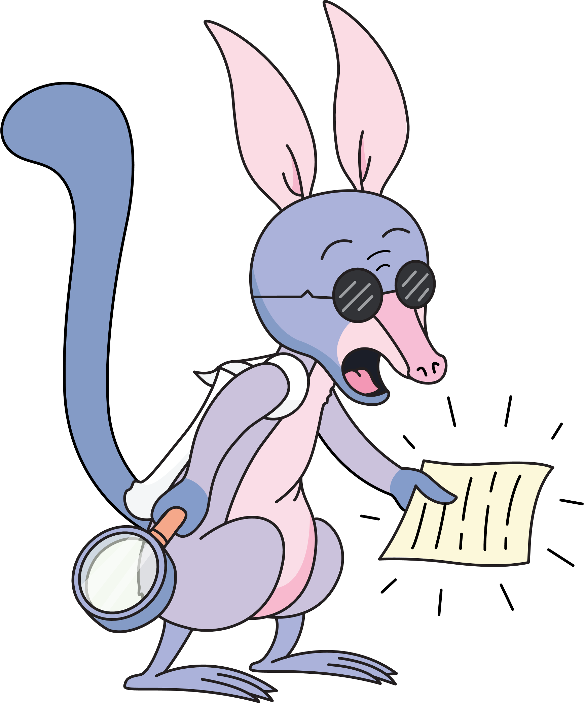
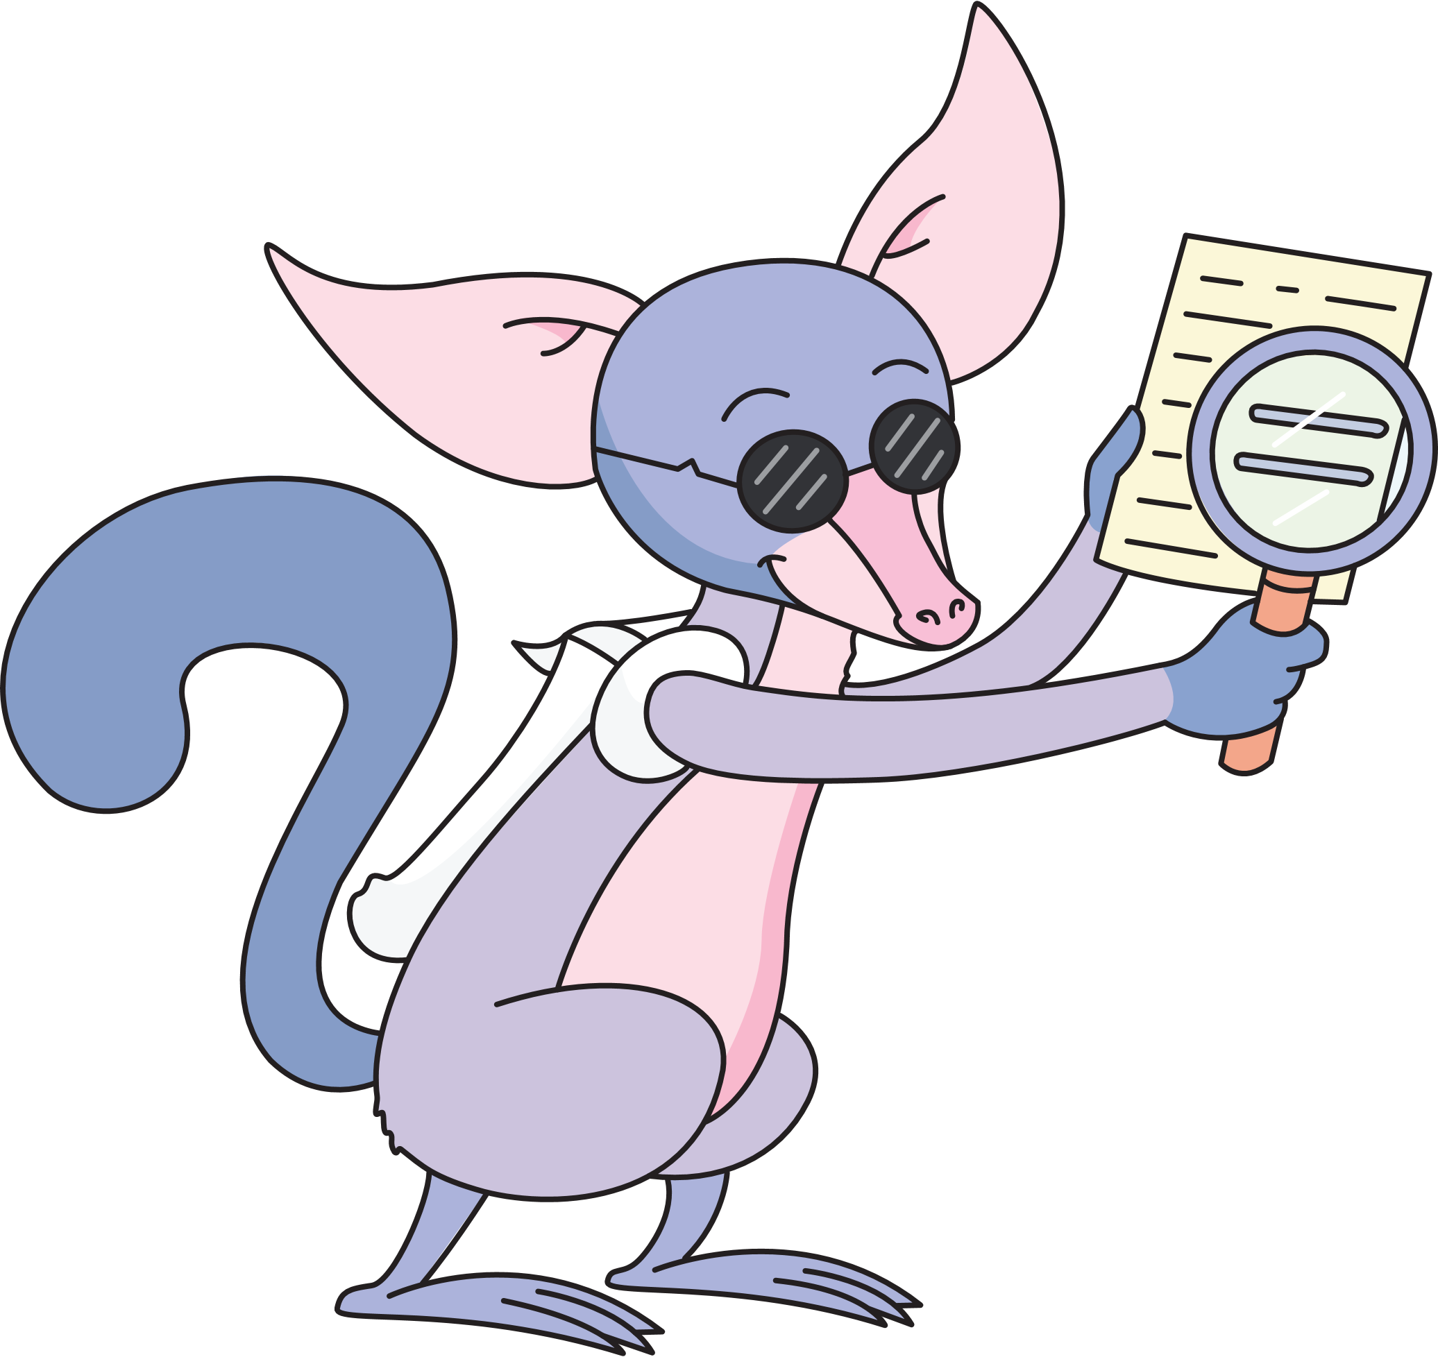
Notes:
Script
And Billie’s ears prick right up. He knows something is up – this does not feel right.

Slide 13
What will the Mighty Heroes do now?
Notes:
Script
The scary videos keep playing – it’s on autoplay!
What will the Mighty Heroes do now?

Slide 14

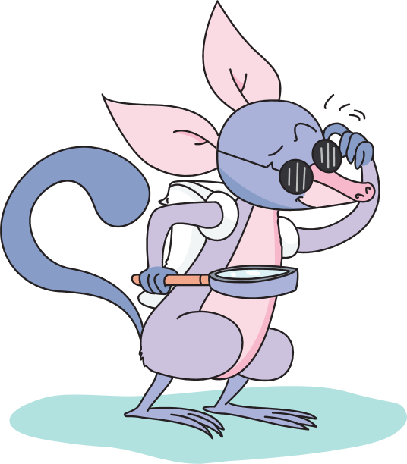
I know! We could throw the tablet up a tree…
Notes:
Script
‘I know!’ says Billie. ‘We could throw the tablet up a tree! We definitely wouldn’t see the scary video then.’

Slide 15

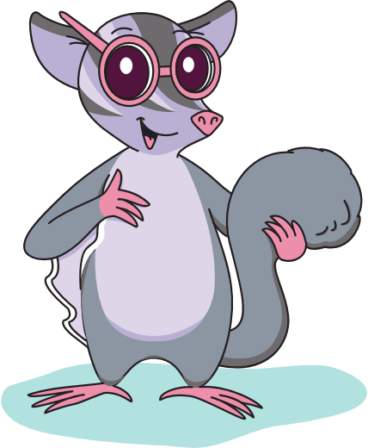
Or even better, let’s bury it!
Notes:
Script
‘Or even better,’ suggests River, ‘let’s bury it!’

Slide 16
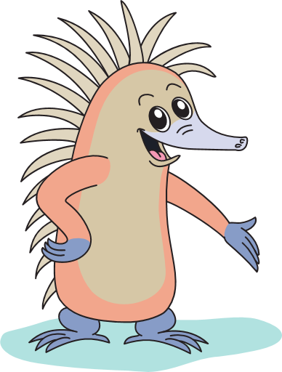
But is that responsible?
Notes:
Script
‘But is that responsible?’ Wanda asks, using her superpower. ‘Don’t we need to look after our devices?’

Slide 17
Notes:
Script
Then… Dusty remembers his superpower!
‘When something doesn’t feel right, we need to ask for help from a trusted adult. Who do we trust who can help us?’

Slide 18
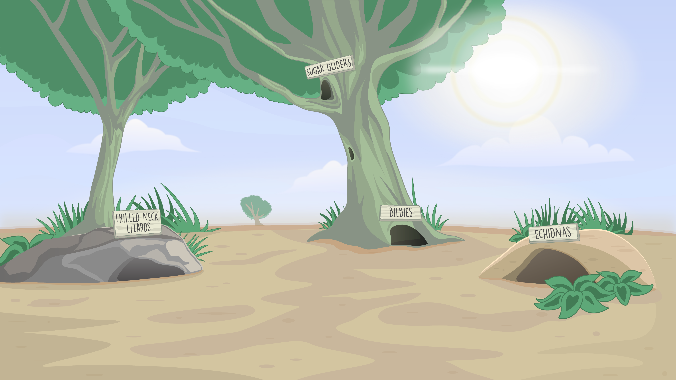
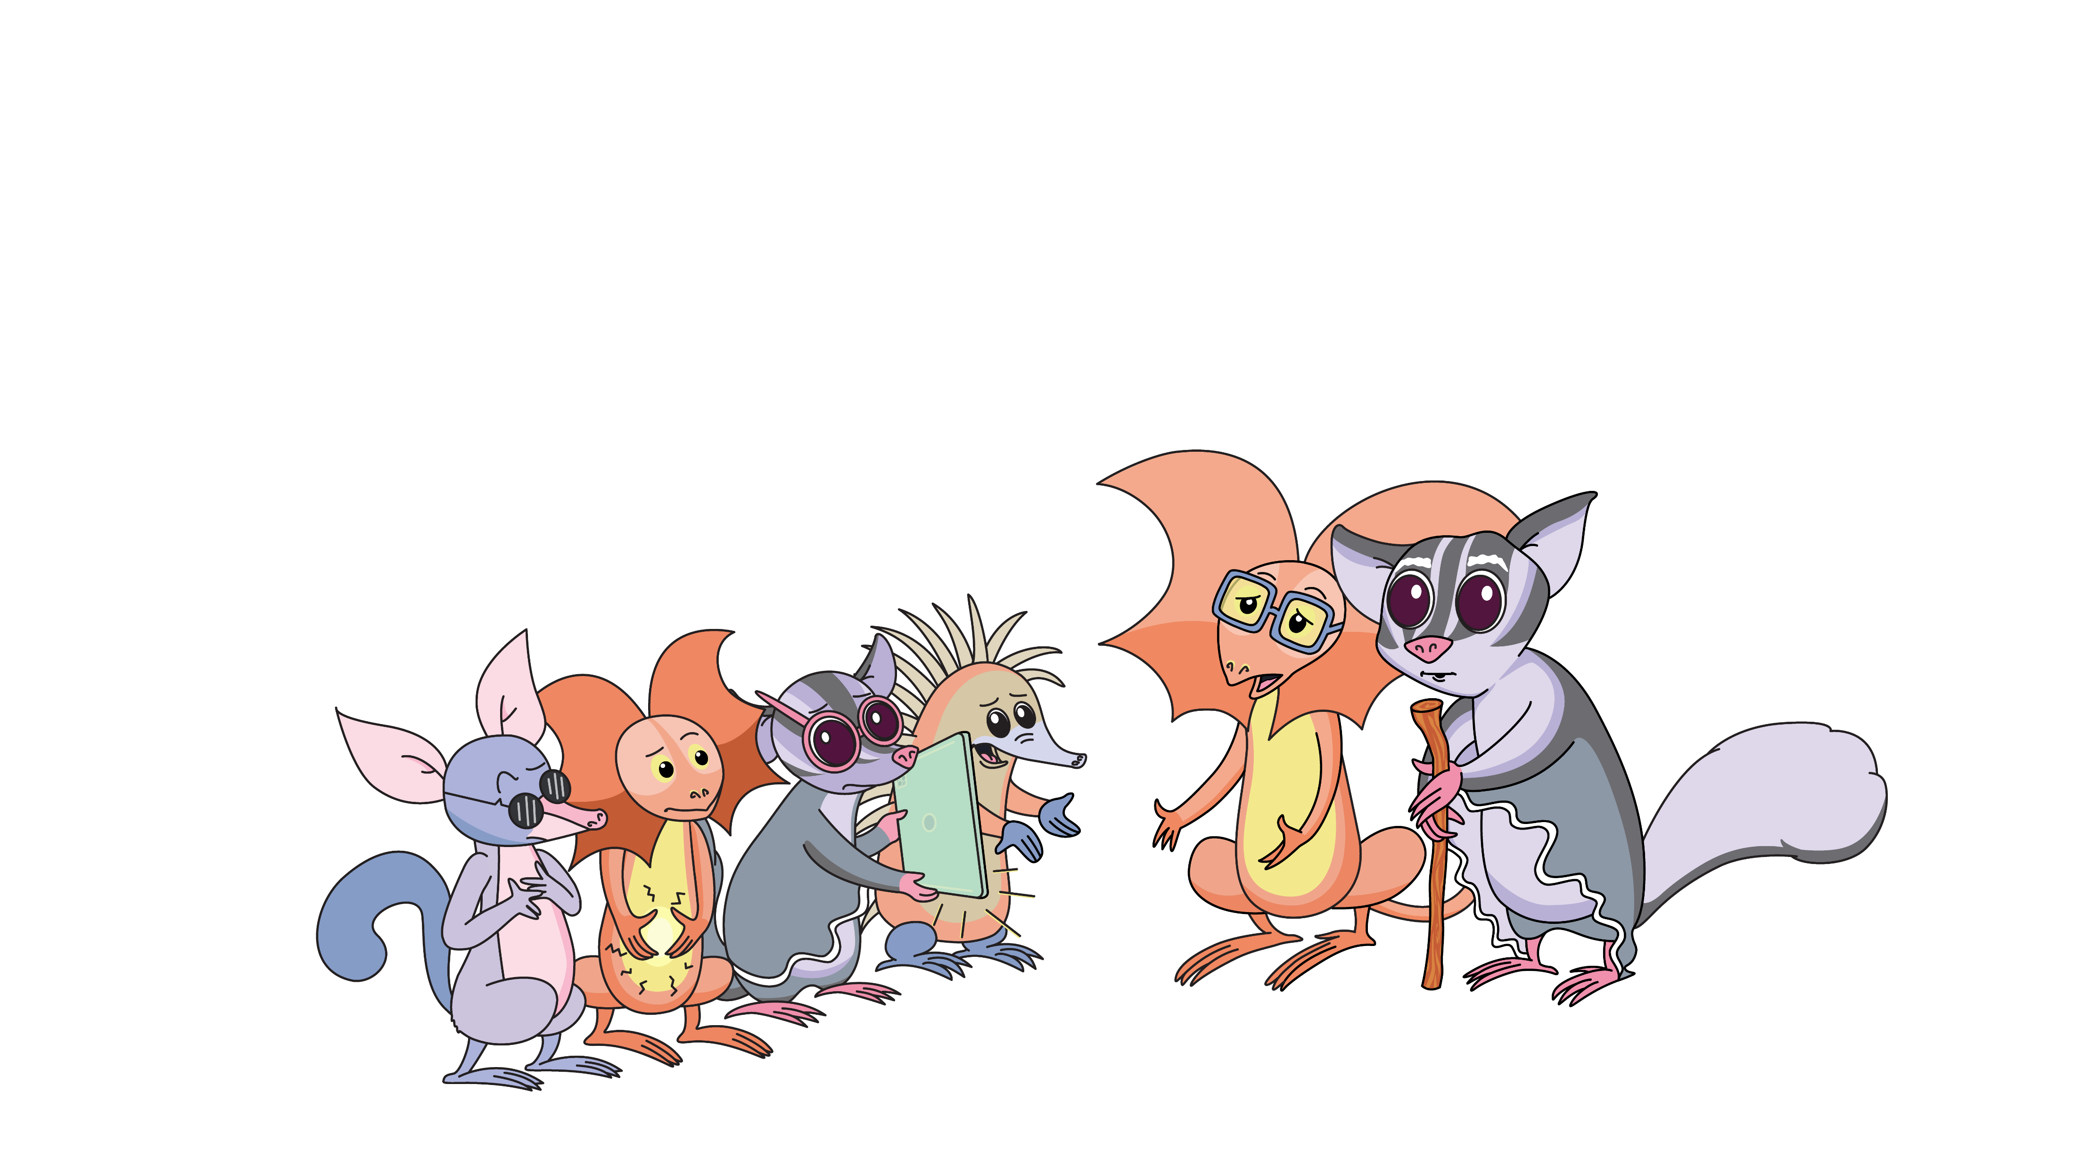
Notes:
Script
The Mighty Heroes rush outside to Dusty’s mum and River’s uncle. They know they will listen and help them to feel safe again.
Dusty’s mum says, ‘You were so right to come and ask for help. Let’s sort out the settings to help make it safer.’
River’s uncle says, ‘And next time, you can come to us if you need help searching for game tips. We can do it together!’

Slide 19
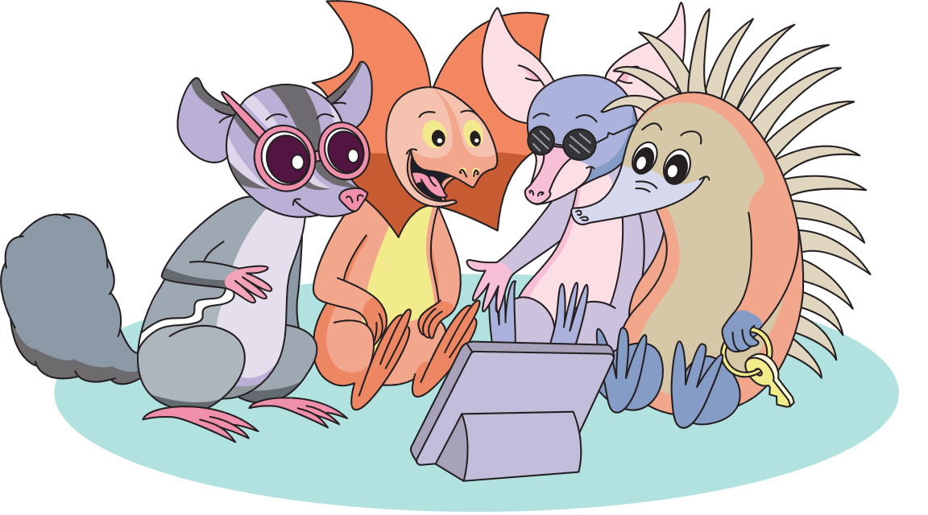
Notes:
Script
How do the Mighty Heroes feel now?
Phew! Much better.
Thanks to Dusty’s superpower, they all know when something doesn’t feel right – their body tells them.
And it’s time to ask for help!

Slide 20
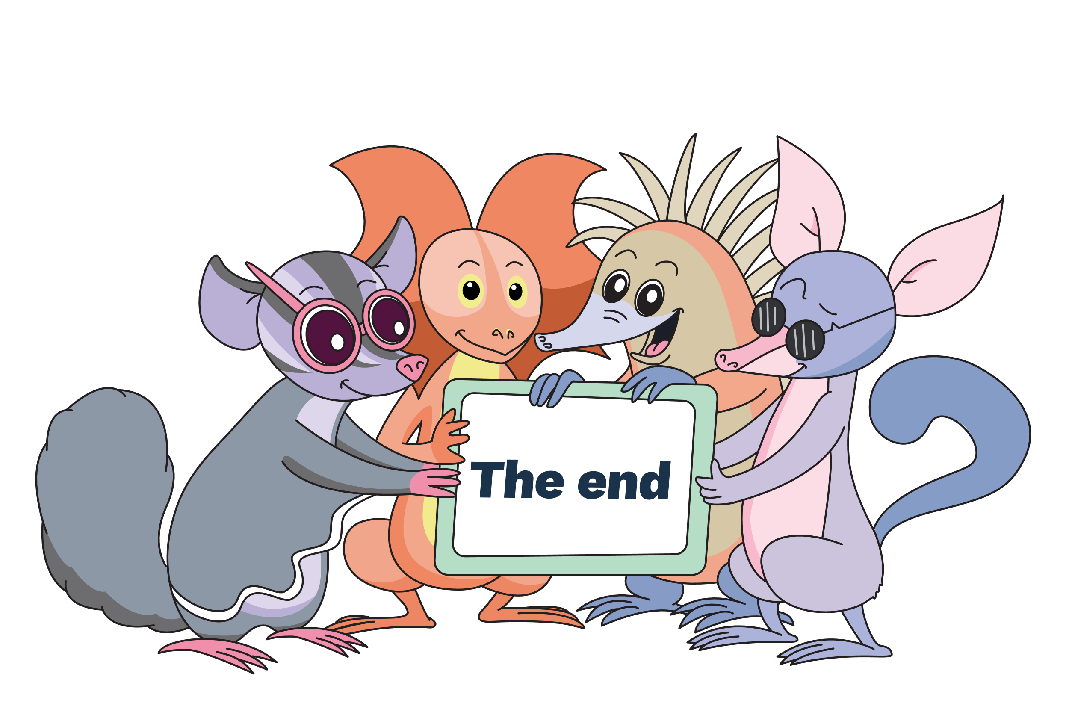
Notes:
The end.

